Slide 1

Data Insights
Sentiment Analysis Presentation
Group Members: Chandresh Patel (200595392)
Nancy Jangwal (200591978)

Slide 2
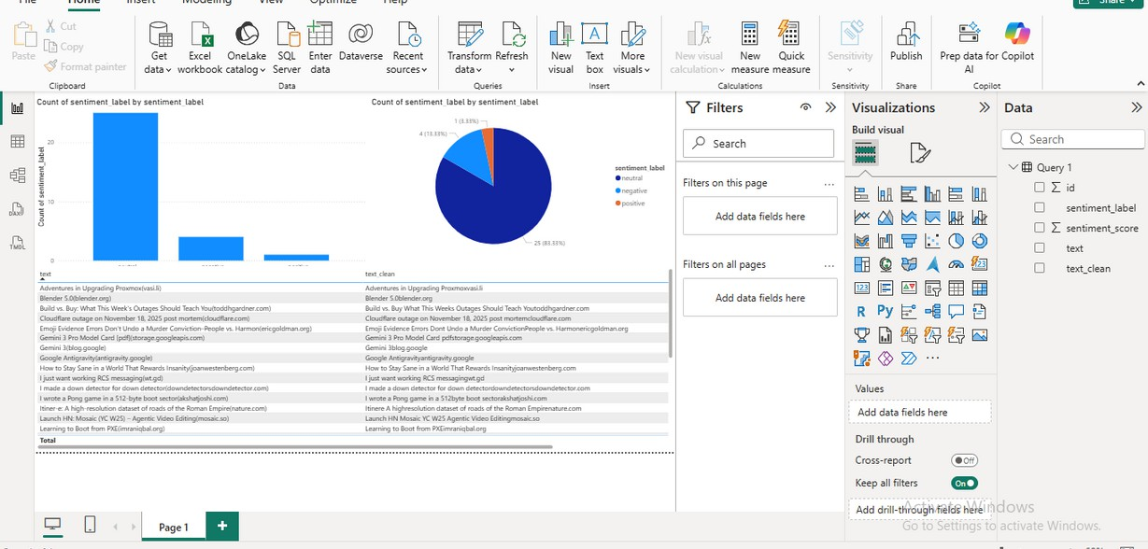
OVERVIEW
Project Workflow Overview
This project demonstrates an end-to-end sentiment analysis workflow using Azure services. The workflow includes: preprocessing text data, uploading CSV to Blob Storage, creating an ADF pipeline, loading data into SQL Database, and visualizing results using Power BI.

Slide 3
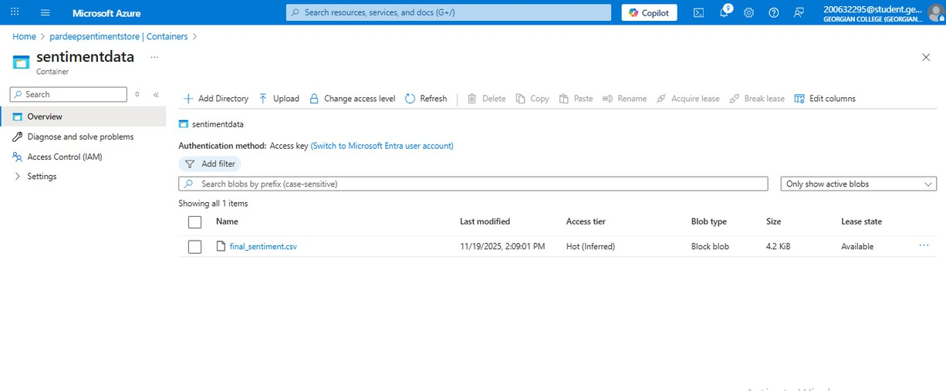
BLOB STORAGE
Uploading CSV Files
The processed final_sentiment.csv file was uploaded to Azure Blob Storage inside a dedicated container. This file serves as the input source for the Azure Data Factory pipeline.

Slide 4
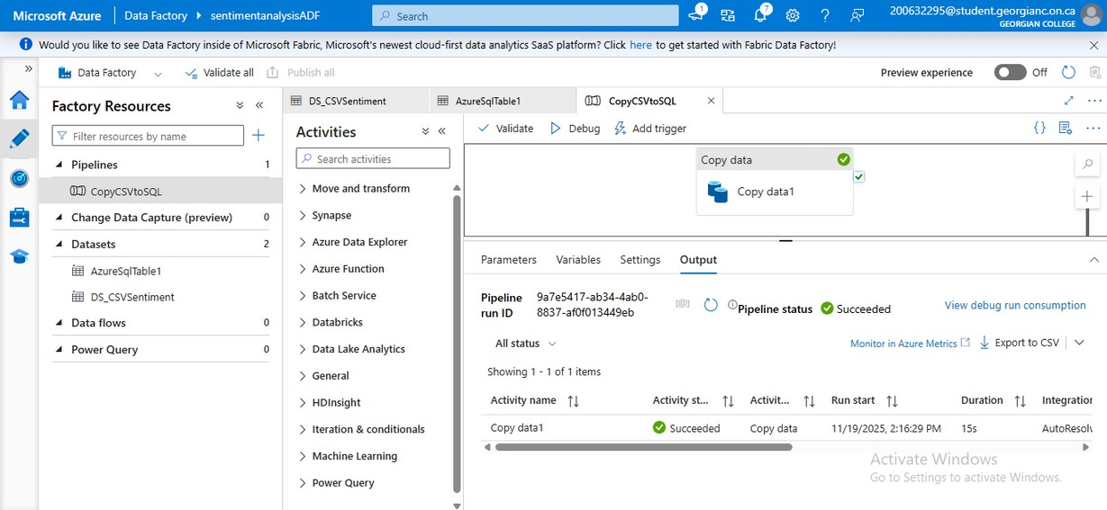
ADF PIPELINE
Pipeline Setup Overview
This section explains the ADF pipeline setup, detailing the Copy Data activity and how to configure linked services for seamless data movement.
An ADF Copy Data pipeline was created to automate the transfer of the CSV file from Blob Storage into Azure SQL Database. The pipeline includes both source and sink configurations.

Slide 5
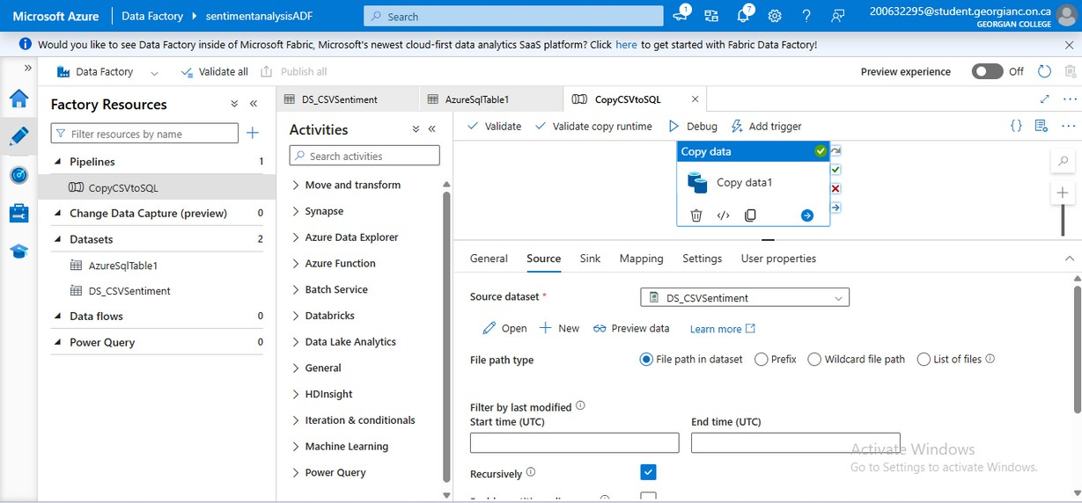
SOURCE DATASET
ADF Source Configuration
In this section, we detail the setup of the source dataset for our ADF pipeline, including CSV handling and schema import processes.
The source dataset was configured to read
the CSV from Blob Storage. Schema was imported automatically from the file and delimiter was set correctly.

Slide 6
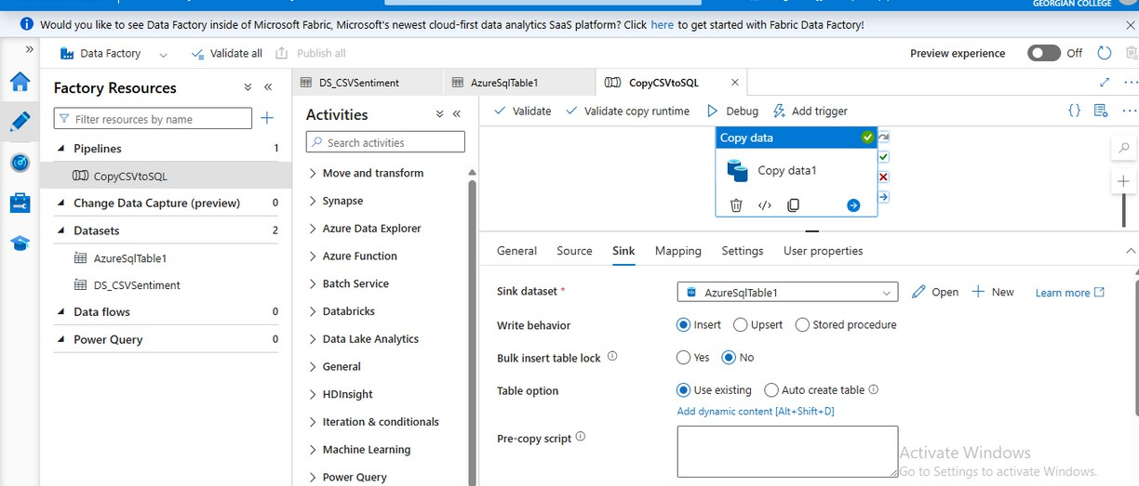
SINK DATASET
Table Mapping Overview
This section details the mapping of tables between the ADF pipeline and the SQL database, ensuring accurate data flow and integrity throughout the process.
The sink dataset was connected to the Azure SQL Database and mapped to the SentimentOutput table. This allowed the CSV data to be inserted into SQL Server.

Slide 7
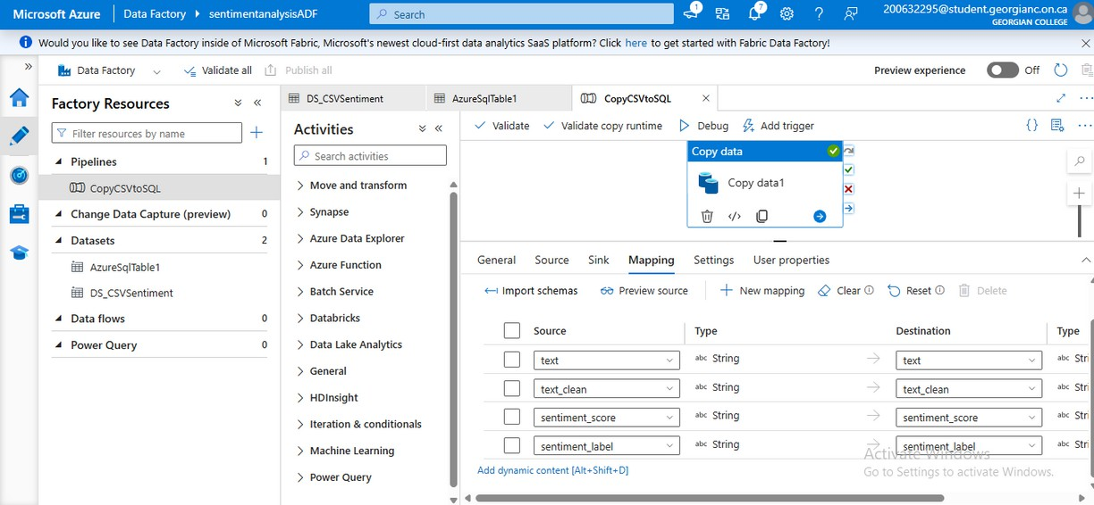
MAPPING
Column Mapping Overview
This section outlines the process of mapping columns between the source CSV data and the destination SQL database to ensure accurate data transfer.
The mapping step ensures that every CSV column is correctly matched to the SQL table: text, text_clean, sentiment_score, sentiment_label.

Slide 8
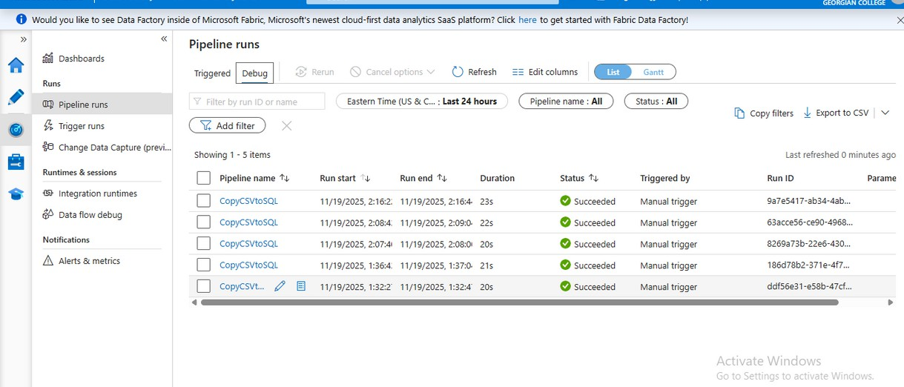
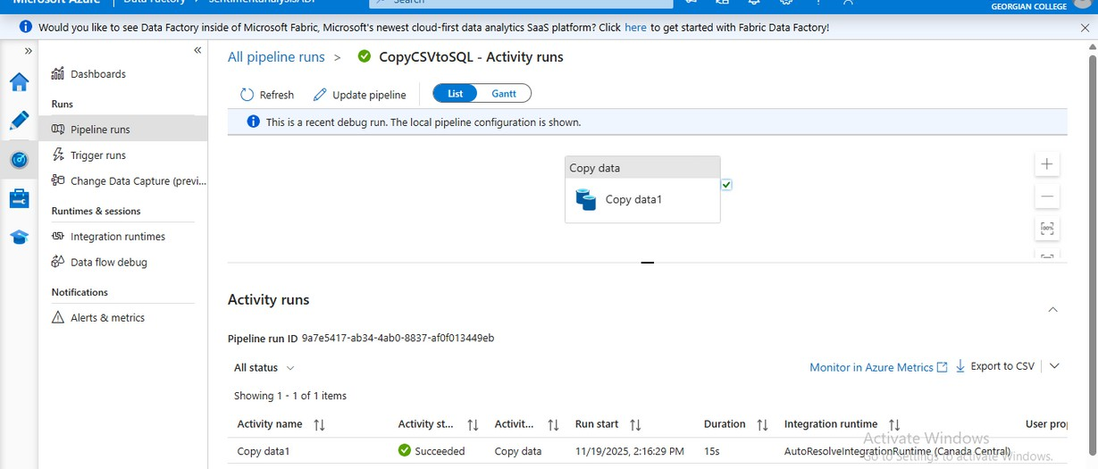
EXECUTION SUCCESS
Pipeline Run Results
The pipeline successfully executed, resulting in the insertion of multiple rows into the SQL database. This indicates correct data flow throughout the ETL process.

Slide 9
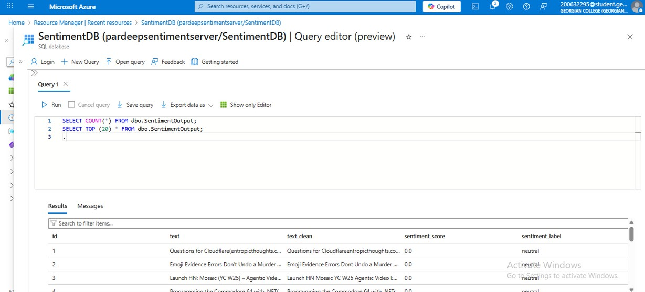
SQL VALIDATION
SQL Query Results
This section highlights the importance of validating SQL data after extraction. Ensure accuracy by reviewing query results to confirm successful data loads into the database.
Data was validated in Azure SQL by running queries such as SELECT COUNT(*) and SELECT TOP(20). This confirms successful data insertion.

Slide 10
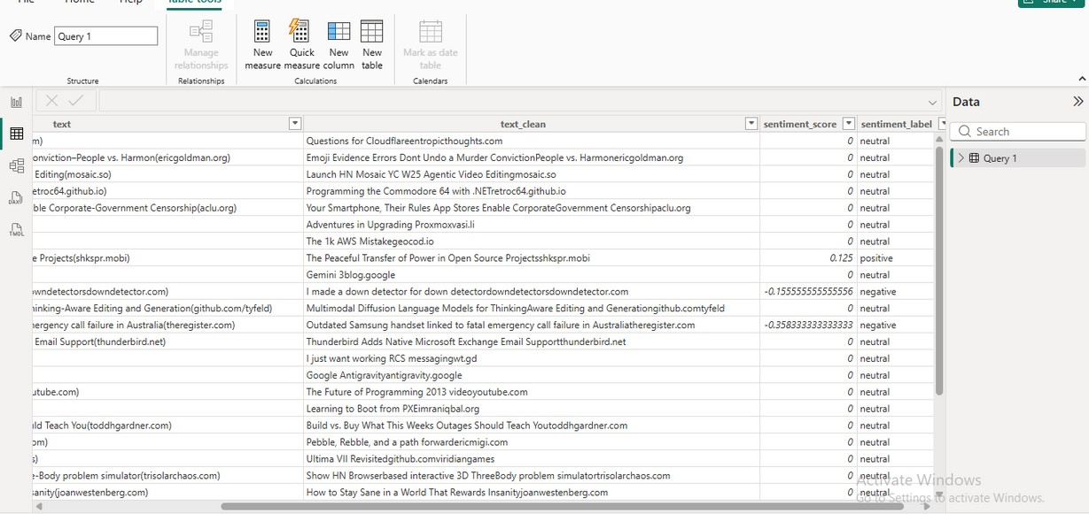
POWER BI
Importing Data from SQL
In this section, we will discuss how to seamlessly import data from the SQL database into Power BI for effective data visualization and reporting.
Power BI was connected to the SQL Database table. The SentimentOutput table was imported successfully for further visualization.

Slide 11
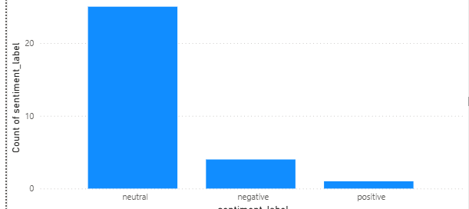
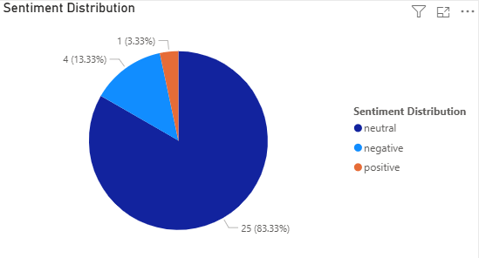
VISUALS
Power BI Charts
This section showcases the dynamic bar and pie charts generated in Power BI, illustrating key sentiment analysis metrics and insights from the data.

Slide 12
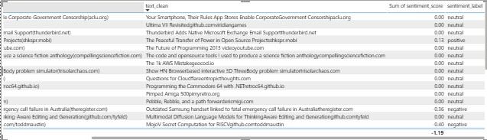
FINAL TABLE
Power BI Visuals – Table
This section illustrates the finalized data table in Power BI, showcasing key metrics and insights derived from the ETL process for effective analysis.

Slide 13
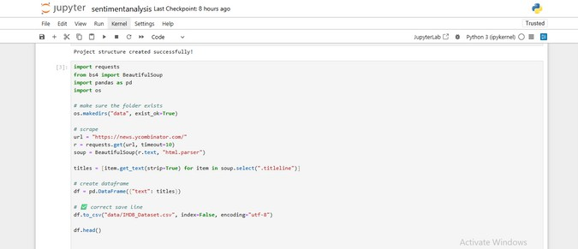
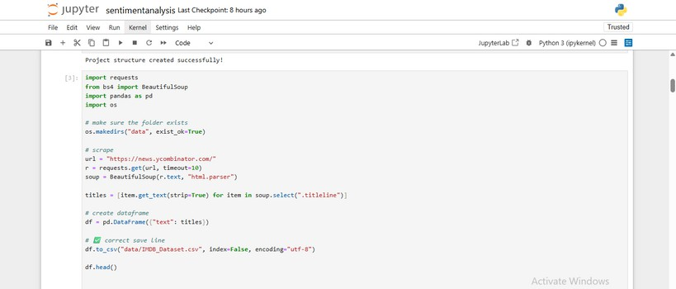
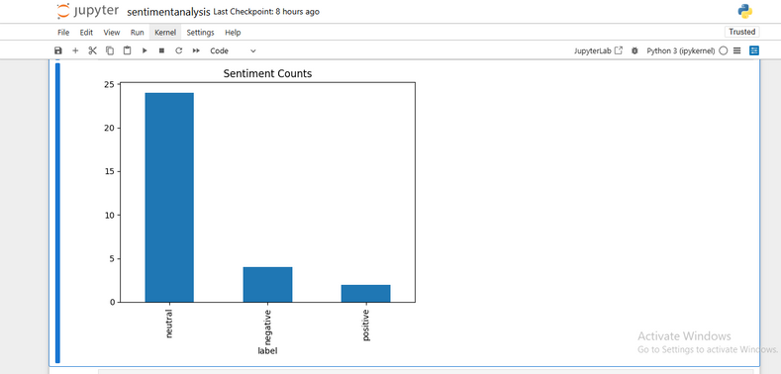
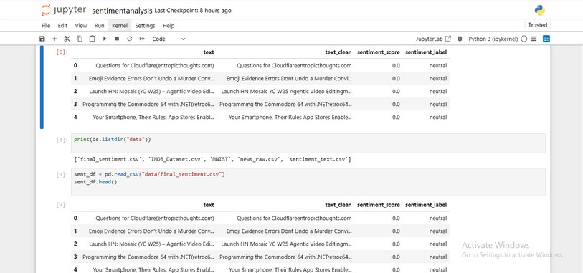
Conclusion
Coding part
This end-to-end pipeline demonstrates data ingestion, processing, storage, and visualization using Azure services. The workflow is scalable and suitable for real-world sentiment analysis scenarios.
Reference:
Loria, S. (2020). TextBlob Documentation. Microsoft Azure (2025). Blob Storage, Data Factory & SQL DB Docs.
Hacker News (2025). News Headlines
Source.
McKinney, W. (2018). Python for Data Analysis.
Microsoft (2025). Power BI Documentation.
Github Link:
https://github.com/chandresh2508/Sentiment_Analysis

Slide 14
Thank you!

